Slide 1
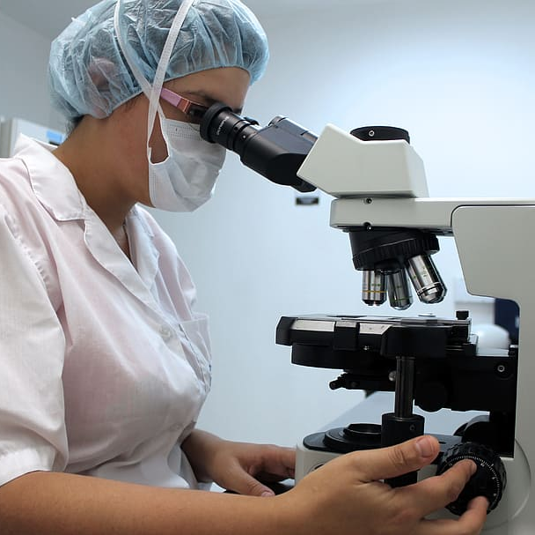
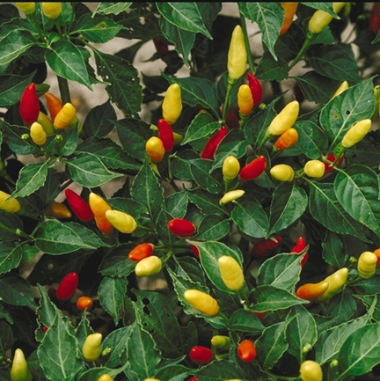
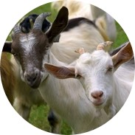
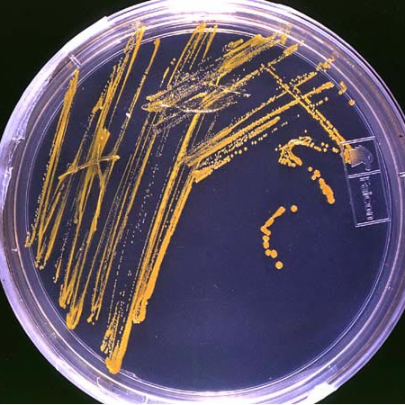
The Nagoya Protocol, the EU ABS Regulation, and the implications for users of genetic resources
Martin Brink
19 November 2024

Slide 2
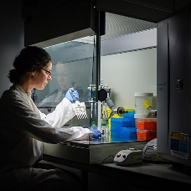
The Nagoya Protocol, the EU ABS Regulation, and the implications for users of genetic resources
Background
The Nagoya Protocol and other international ABS agreements
Implementation of the Nagoya Protocol in the EU and NL
Implications for users of genetic resources
New developments
Key messages

Slide 3
The Nagoya Protocol, the EU ABS Regulation, and the implications for users of genetic resources
Background
The Nagoya Protocol and other international ABS agreements
Implementation of the Nagoya Protocol in the EU and NL
Implications for users of genetic resources
New developments
Key messages

Slide 4


The Nagoya Protocol is about Access and Benefit Sharing (ABS)
What is Access and Benefit Sharing?
  regulation of access to genetic resources and traditional knowledge associated with genetic resources
  sharing of benefits from the use of these between providers and users
What does it mean?
  you cannot always freely take and utilise genetic resources anymore, but may need permission from a government
What forms of benefit sharing exist?
  monetary (e.g. royalties, up-front payments)
  non-monetary (e.g. scientific co-operation, technology transfer)

Slide 5
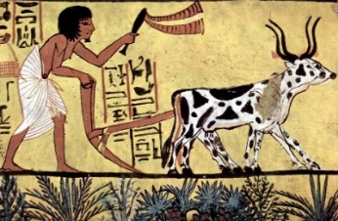
ABS is relatively new
Genetic resources were taken and exchanged freely for thousands of years
  genetic resources were considered ‘common heritage of mankind’
Second half 20th century: increasing role of Intellectual Property Rights for market products based on genetic resources (e.g. in medicine, cosmetics, plant breeding)
  products based on genetic resources were not considered ‘common heritage of mankind’
Recognition that many genetic resources from developing countries were transformed in market products in developed countries
Concept of Access and Benefit-Sharing developed

Slide 6
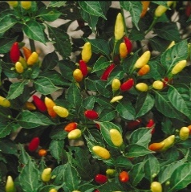

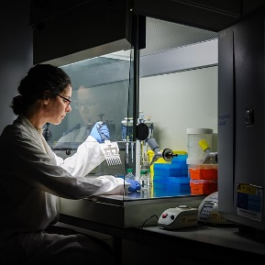
Key definitions
ABS is about access to genetic resources and the sharing of benefits arising from their utilisation
  what are genetic resources?
    any material of plant, animal, microbial or other origin containing functional units of heredity, that is of actual or potential value
    except for human genetic resources
  what is utilisation of genetic resources?
    to conduct research and development on the genetic and/or biochemical composition of genetic resources, including through the application of biotechnology

Slide 7
The Nagoya Protocol, the EU ABS Regulation, and the implications for users of genetic resources
Background
The Nagoya Protocol and other international ABS agreements
Implementation of the Nagoya Protocol in the EU and NL
Implications for users of genetic resources
New developments
Key messages

Slide 8
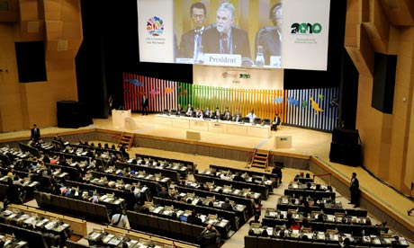
International ABS agreements
Convention on Biological Diversity (CBD)
The Nagoya Protocol on Access to Genetic Resources and the Fair and Equitable Sharing of Benefits Arising from their Utilization (Nagoya Protocol)
International Treaty on Plant Genetic Resources for Food and Agriculture (ITPGRFA)
Pandemic Influenza Preparedness (PIP) Framework for the sharing of influenza viruses and access to vaccines and other benefits (PIP Framework)

Slide 9

Convention on Biological Diversity (CBD)
Negotiated in UNEP (United Nations Environment Programme)
In force since 29 December 1993
196 Parties
Objectives
  conservation of biological diversity
  sustainable use of its components
  fair and equitable sharing of the benefits arising out of the utilization of genetic resources

Slide 10

Convention on Biological Diversity (CBD)
Important elements
  covers all genetic resources
    except human material
  affirms that states have sovereign rights over their genetic resources
  access on the basis of bilateral negotiations between the provider country and the user (unless otherwise determined by that country)

Slide 11
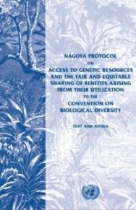
Nagoya Protocol
Protocol to the CBD
In force since 12 October 2014
141 Parties (as of 19 November 2024)
Objective
  the fair and equitable sharing of the benefits arising from the utilization of genetic resources (...), thereby contributing to the conservation of biological diversity and the sustainable use of its components
Like the CBD, the Nagoya Protocol does not apply to human material

Slide 12

The Nagoya Protocol
Principles
  Provider countries are to ensure clear and transparent procedures
  compliance to ABS rules in provider countries is to be monitored by the countries where the genetic resources are utilized
Access to genetic resources on the basis of
  Prior Informed Consent (PIC): permission by authorities of the country providing genetic resources
    unless otherwise determined by that country
  Mutually Agreed Terms (MAT): contract with provider
    including benefit-sharing arrangements
Also provisions on traditional knowledge associated with genetic resources and derivatives

Slide 13
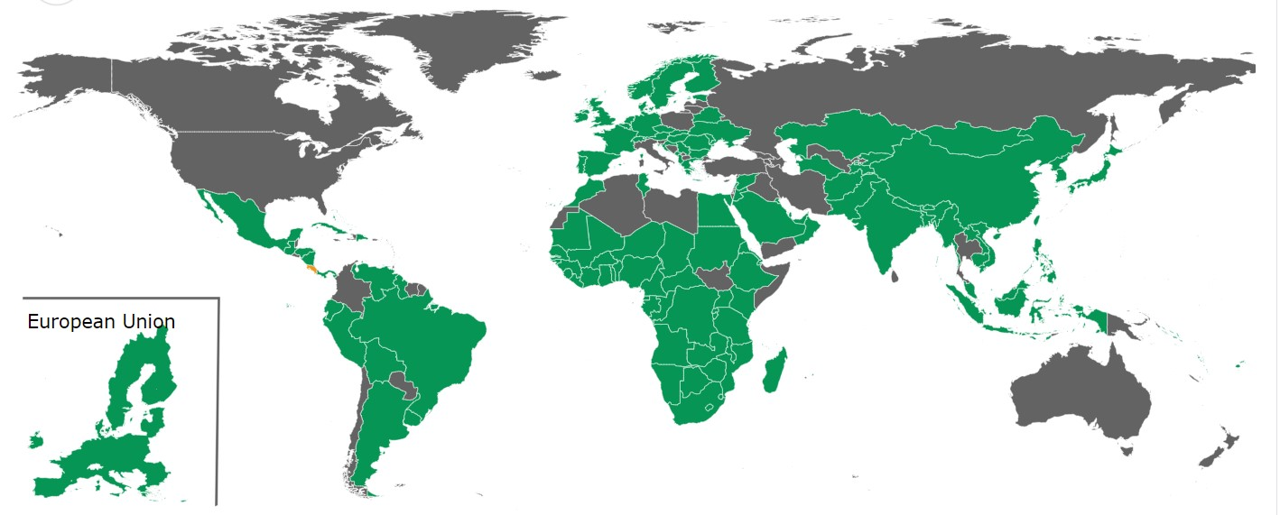
Parties to the Nagoya Protocol
(19 November 2024)

Slide 14

Pandemic Influenza Preparedness (PIP) Framework
Agreed within WHO (World Health Organization)
In force since 24 May 2011
196 Parties
Objective
  to improve pandemic influenza preparedness and response by establishing a system for 1) the global sharing of H5N1 and other influenza viruses with pandemic potential and 2) access to vaccines and sharing of other benefits
ABS aspects
  only covers influenza viruses with human pandemic potential
  multilateral system of benefit-sharing
  access to influenza viruses on the basis of a Standard Material Transfer Agreement (SMTA)

Slide 15
The Nagoya Protocol, the EU ABS Regulation, and the implications for users of genetic resources
Background
The Nagoya Protocol and other international ABS agreements
Implementation of the Nagoya Protocol in the EU and NL
Implications for users of genetic resources
New developments
Key messages

Slide 16


Implementation Nagoya Protocol in EU and NL
EU
  The EU ABS Regulation (Regulation (EU) 511/2014)
    published in 2014; legally binding
  Implementing Regulation (EU) 2015/1866
    published in 2015; legally binding
  Guidance document
    published in 2016; revised 2021; gives explanations, not legally binding
NL
  Nagoya Protocol (Implementation) Act
    published in 2015

Slide 17
The EU ABS Regulation (Regulation (EU) 511/2014)
Implements compliance aspects of the Nagoya Protocol in the EU
  only deals with compliance, NOT with access
  access regulated by individual countries, not at EU level
Entry into force: 12 October 2014
  Applies to genetic resources
    accessed from 12 October 2014 onwards
    accessed from a country that is a Party to the Nagoya Protocol and has established access measures
    utilised in R&D within the EU (commercial and non-commercial)
  Legally binding for all companies, institutions and individuals within the EU
  National legislation in provider countries may go further than the EU ABS Regulation

Slide 18

The EU ABS Regulation:
User obligations (Art. 4)
  To exercise ‘due diligence’ to ascertain that the genetic resources (and associated traditional knowledge) they utilise have been legally acquired, and that benefits are shared
  To utilise and transfer genetic resources in accordance with the MAT (Mutually Agreed Terms)
  Therefore:
    seek relevant ABS information
    obtain required permits and contracts
    keep ABS information for 20 years after end utilisation
    transfer relevant ABS information to subsequent users

Slide 19
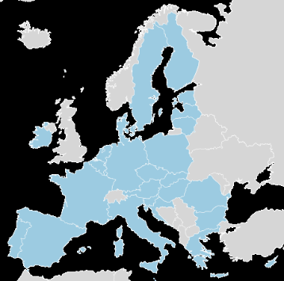
The EU ABS Regulation:
Member State obligations (Art. 7, 9, 11)
  Lay down rules on penalties in case of non-compliance
    “effective, proportionate and dissuasive”
  Carry out checks to monitor compliance of users
  Request users to submit a ‘due diligence declaration’
    when external funding is received for research project using genetic resources
    at the stage of final development of a product developed via the utilisation of genetic resources

Slide 20
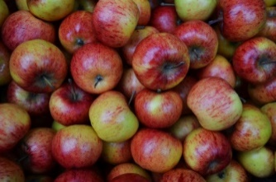
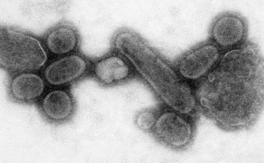
The EU ABS Regulation:
Specialised International Instruments (Art. 2)
  The EU ABS Regulation does not apply when ABS of genetic resources is covered by a ‘Specialised International Instrument’ (Art. 2)
  Instruments recognized by the EU:
    International Treaty on Plant Genetic Resources for Food and Agriculture (ITPGRFA)
      plant genetic resources for food and agriculture
    Pandemic Influenza Preparedness Framework (PIP-framework)
      influenza viruses with human pandemic potential
In the future probably more specialised international instruments will be recognized

Slide 21

Implementing Regulation (EU) 2015/1866
Entry into force: 9 November 2015
Legally binding
Lays down more detailed rules on the implementation of certain articles of the EU ABS Regulation
  due diligence declarations
  EU register of trusted collections
  Best practices
Annexes:
  information to be provided
  templates

Slide 22

EU Guidance Document
First version 2016; revised version 2021
Not legally binding; explains EU ABS Regulation
Explanation ‘utilisation’ = basic research, applied research and/or product development
  if an activity creates new insight into characteristics of the genetic resource which is of (potential) benefit to the further process of product development, it falls under the term ‘utilisation’
Two main parts
  main text
  Annex 2

Slide 23

EU Guidance Document: Main text
  Introduction
  Scope of the EU ABS Regulation
  Obligations of users
    due diligence obligation
    specific situations
  Events triggering due diligence declarations
    external research funding
    final development of product
  Sector specific issues
    health
    food and agriculture

Slide 24

EU Guidance Document: Scope
EU ABS Regulation (cumulative)
  Geographic scope
    applicable to GR from countries which are a Party to the Nagoya Protocol and have established access measures
    applicable to utilisation within EU territory
  Temporal scope
    applicable to GR accessed from 12 Oct 2014 onwards
  Material scope
    applicable to the utilisation of genetic resources and of traditional knowledge associated with GR
    utilisation (R&D) includes basic research, applied research and product development
  Personal scope
    applicable to all users of GR resources

Slide 25

EU Guidance Document: What is utilization?
Important element of the main text is about the question: what is ‘utilisation’? (section 2.3.3)
Examples of ‘utilisation’
  research to discover specific genetic and/or biochemical properties
  creation and improvement of genetic resources to be used in production processes
  genetic modification
Examples of ‘no utilisation’
  identification
  maintenance and management of a collection for conservation purposes
  genetic resources as testing/reference tools

Slide 26
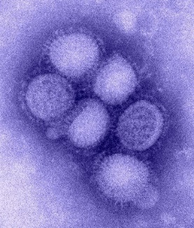
EU Guidance Document
Health as sector-specific issue (section 5.1)
  pathogenic organisms that pose a threat to human, animal or plant health fall generally within the scope of the EU ABS Regulation
    except those covered by specialised ABS instruments, such as WHO Pandemic Influenza Preparedness (PIP) Framework
  Parties required to pay due regard to cases of present or imminent emergencies that threaten or damage human, animal or plant health
  special status to pathogenic organisms (likely) causing a present or imminent public health emergency of international concern or a serious cross-border threat to health
    extended deadline for compliance with the due diligence obligations

Slide 27

EU Guidance Document
Unintentionally introduced pathogenic genetic resources and pests (Section 2.3.1.5)
  When pathogenic organisms or pests present on a human, an animal, a plant, a micro-organism, food, feed or any other material are introduced unintentionally into the EU, they fall outside the scope of the EU ABS Regulation, as there was/is no intention of introducing the pathogens as genetic resources
    e.g. when travellers who are unknowingly infected with a virus travel into an EU country
  But: if the pathogenic organisms or pests are established in situ in an EU country following introduction, utilisation of these genetic resources may be in scope of that country’s ABS legislation

Slide 28
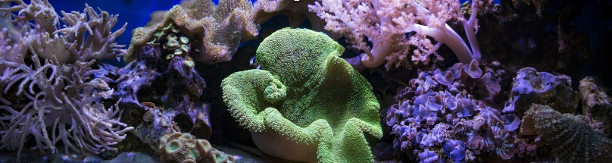
EU Guidance Document: Annex II
  Provides specific guidance on when genetic resources are considered to be utilised in the meaning of the EU ABS Regulation (assuming they fall in the geographical, temporal and material scopes)
  Follows logic of the value chain, starting from acquisition to placing of a product on a market
  Contains many examples (cases) drawn from different sectors, often based on feedback from stakeholders

Slide 29

EU Guidance Document: Annex 2
  Introduction
  Acquisition
  Storage and collection management
  Rearing and multiplication
  Exchange and transfer
  Identification of organisms and other activities at the beginning of the value chain
  Genetic resources as tools
  Breeding
  Product development, processing and product formulation
  Product testing
  Marketing and application

Slide 30
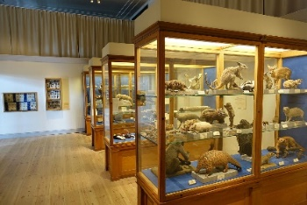
EU Guidance Document: Storing and collection management
Annex II, chapter 3: Storing and collection management
  Storing genetic resources in a public or private collection does not constitute utilisation in the sense of the EU ABS Regulation
  Verification the identity of genetic resources and assessing their health status and the presence of pathogens form an integral part of collection management and are not considered to be utilisation in the meaning of the EU ABS Regulation
  General good practice of collection holders upon receiving material is to check if the original permits for collecting genetic resources allow supply to third-party users
    if so: make the information on the permits available for potential users and to supply it together with any material to the potential users

Slide 31

Case ‘Storing and collection management’
  Storage of pathogens pending a decision on their use in a vaccine
  Different pathogens are isolated from hosts in various countries as part of global surveillance systems and considered from epidemiological analysis to be a potential public health threat. Initial analysis does not make it clear which, if any, of the isolates will be needed for vaccine development. However, the threat is considered sufficiently great that preparation of vaccines and diagnostics is requested by WHO and by individual governments around the world. Therefore, these pathogens are collected and stored in an already existing collection, as well as exchanged with other collections.
  Is the storage of pathogens ‘utilization’ in the meaning of the EU ABS Regulation?
  Is the development of vaccines on the basis of these stored pathogens ‘utilization’ in the meaning of the EU ABS Regulation?

Slide 32
Case ‘Storing and collection management’
  Storage of pathogens pending a decision on their use in a vaccine
  Building up a collection of pathogens with the aim to use them in case of further needs is not considered to constitute utilisation in the meaning of the EU ABS Regulation. However, if at a later stage the vaccine candidates are used to develop a vaccine, this is research and development on the genetic or biochemical composition of the genetic resource and such activity would fall within the scope of the EU ABS Regulation.
  So, the storage of pathogens is no ‘utilization’ in the meaning of the EU ABS Regulation
  The development of vaccines on the basis of these stored pathogens, on the other hand, is ‘utilization’ in the meaning of the EU ABS Regulation

Slide 33

EU Guidance Document:
Genetic resources as tools
Annex II, section 7.1: Using genetic resources as testing or reference tools
  The application of genetic resources as testing or reference tools is not considered to constitute utilisation in the meaning of the EU ABS Regulation.
  This is because at that stage the material is not the object of the research in itself but only serves to confirm or verify the desired features of other products developed or under development.

Slide 34
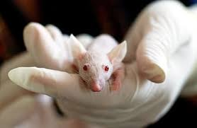
Case ‘Genetic resources as tools’
  Use of animals in animal test models
  The efficacy of a chemically synthesised compound is tested in an animal test model in an EU country. The animal test model involves rats that show a certain type of cancer.
  Is this ‘utilization’ in the meaning of the EU ABS Regulation?

Slide 35
Case ‘Genetic resources as tools’
  Investigation of function of genes: established introduced species
  The rats are used as tools for research and development. Research and development is not carried out on the rats. Therefore, the use of the rats to test the compound does not constitute utilisation of genetic resources in the meaning of the EU ABS Regulation.
  So, this activity is no ‘utilization’ in the meaning of the EU ABS Regulation

Slide 36
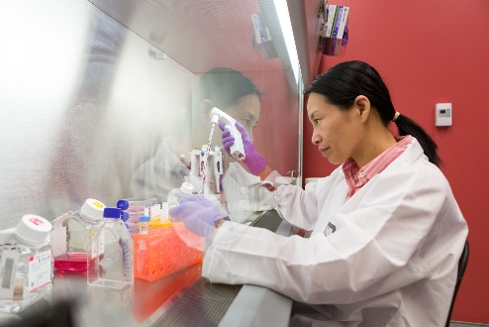
EU Guidance Document: Biofactory
Annex II, section 7.4: Biofactory
  Genetic resources may be exploited to produce active compounds, which are subsequently extracted.
  This use of a genetic resource as a biofactory does not amount to utilisation in the meaning of the EU ABS Regulation, since it does not involve research and development on the genetic and/or biochemical composition of this genetic resource.
  However, if it is combined with research and development on the genetic and/or biochemical composition of that genetic resource, e.g. to discover specific genetic and/or biochemical functions that may optimise compound production, this research would qualify as utilisation in the meaning of the EU ABS Regulation.

Slide 37
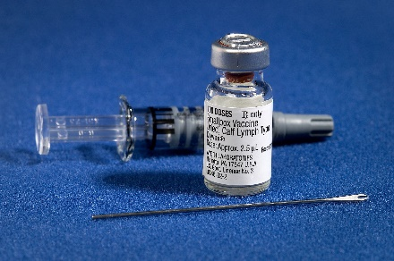
Case ‘Biofactory’
  Use and engineering of animal cells for vaccine manufacturing
  Animal cells are imported for use in an established manufacturing process for virus vaccines.
  Animal cells are imported in order to develop a new manufacturing process for influenza vaccines and then engineered for high growth properties.
  Is the use of animal cells in an established manufacturing process for virus vaccines ‘utilization’ in the meaning of the EU ABS Regulation?
  Is the engineering of animal cells for high growth properties ‘utilization’ in the meaning of the EU ABS Regulation?

Slide 38
Case ‘Biofactory’
  Use and engineering of animal cells for vaccine manufacturing
  As long as no research and development is performed on the animal cells, the use in an established manufacturing process for virus vaccines does not constitute utilisation in the meaning of the EU ABS Regulation.
  When animal cells are developed for high growth properties this activity can be considered as being utilisation in the meaning of the EU ABS Regulation.
  So, the use and engineering of animal cells for vaccine manufacturing is no ‘utilization’ in the meaning of the EU ABS Regulation
  The development of animal cells for high growth properties is ‘utilization’ in the meaning of the EU ABS Regulation

Slide 39
National legislation NL
Nagoya Protocol (Implementation) Act (with Explanatory Memorandum, Regulation and Decrees)
  implements Nagoya Protocol in NL
  into force: 23 April 2016
  Competent National Authority (CNA): Ministry of Economic Affairs (now: Ministry of Agriculture, Nature and Food Quality)
  monitoring agency: Netherlands Food and Consumer Product Safety Authority (NVWA)
  National Focal Point (NFP): Centre for Genetic Resources, the Netherlands (CGN)
  Access to Dutch genetic resources not regulated: Prior Informed Consent (PIC) not needed

Slide 40
The Nagoya Protocol, the EU ABS Regulation, and the implications for users of genetic resources
Background
The Nagoya Protocol and other international ABS agreements
Implementation of the Nagoya Protocol in the EU and NL
Implications for users of genetic resources
New developments
Key messages

Slide 41

What to do as a user?
  Check the access rules of the provider country
    ABS Clearing House (https://absch.cbd.int/)
    National Focal Point (NFP) of the provider country
  Check if the material can be obtained through a specialised international ABS instrument (ITPGRFA; PIP Framework).
    If yes, sign a Standard Material Transfer agreement (SMTA)
    If no, continue with 3-8
  If required, seek permission from the Competent National Authority (CNA) of the provider country (PIC: ‘Prior Informed Consent’)
  Negotiate conditions with provider, and lay these down in a contract (MAT: ‘Mutually Agreed Terms’)

Slide 42
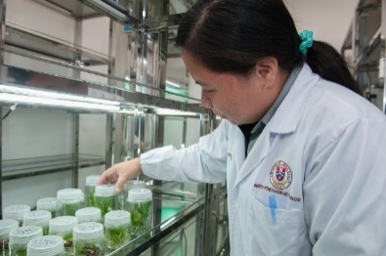
What to do as a user?
  Use the genetic resources only in accordance with the conditions agreed with the provider and laid down in the MAT
    if the intended use changes, new PIC and MAT may need to be obtained
  Carefully document the use
  Keep all documentation for 20 years after the end of utilisation
  Submit a ‘due diligence declaration’ (through https://webgate.ec.europa.eu/declare/) when you
    receive external research funding, or
    bring a product on the market
  Pass on information to further users of the genetic resources

Slide 43

What to document?
Internationally-recognised certificate of compliance (placed by provider country on the ABS Clearing House website)
OR
Information/documents on:
  date and place of access of resources or traditional knowledge;
  description of the genetic resources or of traditional knowledge;
  source from which the genetic resources or traditional knowledge associated with genetic resources were obtained, as well as subsequent users (development chain);
  rights and obligations relating to access and benefit-sharing including for subsequent applications and commercialisation;
  access permits, where applicable (Competent National Authority);
  mutually agreed terms, including benefit-sharing arrangements, where applicable

Slide 44

Some further points of attention
In the EU ABS Regulation, the user is responsible for compliance, not the supplier
  if genetic resources for R&D are bought from a trader, request access documentation
The utilisation in R&D of genetic resources bought abroad from a local market may also fall under the EU ABS Regulation
Some EU countries have access legislation
  the obligations of the EU ABS Regulation may also apply to material from these EU countries
USA is not foreseen to join the Nagoya Protocol
  EU ABS Regulation rules do not apply to US genetic resources (but only if they are really from USA)
National legislation in provider countries may go further than the EU ABS Regulation

Slide 45

Some recommendations
Seek advice and help from local counterparts
Find out if the genetic resource can be obtained
  under a specialised international instrument (ITPGRFA, PIP-Framework)
  from a collection included in the EU Register
Try to conclude a framework agreement between your organisation and the provider country
Keep documentation on genetic resources that do not fall under the EU ABS Regulation, to make plausible that these were legally accessed
Take ABS aspects into account from the very start of the project

Slide 46
The Nagoya Protocol, the EU ABS Regulation, and the implications for users of genetic resources
Background
The Nagoya Protocol and other international ABS agreements
Implementation of the Nagoya Protocol in the EU and NL
Implications for users of genetic resources
New developments
Key messages

Slide 47

New developments
International instrument for Digital Sequence Information (DSI) on genetic resources
International instrument on the conservation and sustainable use of marine biological diversity in areas beyond national jurisdiction (BBNJ)
Enhancement of the Multilateral System of the International Treaty on Plant Genetic Resources for Food and Agriculture (ITPGRFA)
Pathogen Access and Benefit-Sharing (PABS) System

Slide 48

Digital Sequence Information (DSI)
“DSI” is discussed in various international fora, e.g.
  Convention on Biological Diversity (CBD) / Nagoya Protocol
  International instrument on the conservation and sustainable use of marine biological diversity in areas beyond national jurisdiction (BBNJ)
  World Health Organization (WHO)
  International Treaty on Plant Genetic Resources for Food and Agriculture (ITPGRFA)
Main discussion forum: CBD
Term “DSI” not defined, but used as ‘placeholder’
  primarily refers to information on the genetic composition of organisms

Slide 49
Digital Sequence Information (DSI)
CBD meeting Montreal, December 2022
  Agreement that Multilateral Mechanism (MLM) for DSI would be established, with a global fund for benefit-sharing
CBD meeting Cali, October-November 2024
  Operationalisation of MLM for DSI:
    scope: databases that make DSI publicly available
    open access maintained
    larger companies in sectors relying on DSI are encouraged to contribute to the benefit-sharing fund
    indicative rates: 0.1% of revenues or 1% of profits
    contributors receive certificate as ‘license to operate’, providing legal certainty
    fund to be used for the conservation and sustainable use of biodiversity in developing countries
    50% of funds go to Indigenous Peoples and Local Communities

Slide 50

Pathogen Access and Benefit-Sharing (PABS) System
A multilateral system for access and benefit sharing for pathogens with pandemic potential
Addressing physical samples as well as sequence information
Coordinated and convened by the World Health Organization (WHO)
Originally planned to be adopted during the last WHO World Health Assembly in May-June 2024
However, Member States did not succeed in adopting the Agreement
Difficult issues include
  who should have access?
  who should share benefits?
  which types of benefits must be shared?
Negotiations are extended, with a view for adoption in December 2024, with a final deadline for May 2025

Slide 51
The Nagoya Protocol, the EU ABS Regulation, and the implications for users of genetic resources
Background
The Nagoya Protocol and other international ABS agreements
Implementation of the Nagoya Protocol in the EU and NL
Implications for users of genetic resources
New developments
Key messages

Slide 52



Key messages
The concept of Access and Benefit Sharing (ABS) was already established by the Convention on Biological Diversity (CBD) in 1993.
The Nagoya Protocol, in force since 2014, obliges countries where genetic resources are used to monitor compliance to ABS rules.
The EU ABS Regulation, in force since 2014, is a European law that implements the compliance aspects of the Nagoya Protocol in the EU. It contains obligations for users and for governments in the EU.
According to the interpretation of the EU ABS Regulation, ‘utilization' may include basic research, applied research and/or product development.
The EU Guidance document gives detailed explanations and examples related to the EU ABS Regulation.

Slide 53
Key messages
The ABS Regulation does not cover access rules of EU member states; these are decided upon by countries themselves.
Access to Dutch genetic resources is not regulated: Prior Informed Consent (PIC) is not needed.
National legislation in non-EU provider countries may go further than the EU ABS Regulation.
“Digital Sequence Information” (“DSI”) does not fall under the Nagoya Protocol and the EU ABS regulation, but a multilateral ABS-system for DSI is being established under the CBD, with a global benefit-sharing fund.
Negotiations on a multilateral Pathogen Access and Benefit-Sharing (PABS) system under the WHO, addressing physical samples as well as sequence information of pathogens with pandemic potential, are still ongoing.

Slide 54

More information
Website CBD / Nagoya Protocol (www.cbd.int)
  maintained by CBD/NP
  lists of Parties to CBD and NP and contact points
  information on meetings and processes
ABS Clearing House (absch.cbd.int/)
  maintained by CBD/NP
  country information (contact persons, laws)
WHO website (www.who.int)
  information on Pandemic Influenza Preparedness (PIP) Framework (www.who.int/news-room/questions-and-answers/item/pandemic-prevention--preparedness-and-response-accord)
  information on the future Pathogen Access and Benefit-Sharing (PABS) System (www.who.int/news-room/questions-and-answers/item/pandemic-prevention--preparedness-and-response-accord)

Slide 55
More information
ABS website of the EU (http://ec.europa.eu/environment/nature/biodiversity/international/abs/legislation_en.htm)
  maintained by European Commission
  information on EU rules
  EU registers of collections and recognized ‘best practices’
Website of National Focal Point NL (www.absfocalpoint.nl)
  bilingual (Dutch/English)
  information on rules and what to do
  interactive help tool
  news articles on new developments (e.g. DSI)
  subscription to ABS newsletter
  FAQ

Slide 56
Thank you for your attention!
www.absfocalpoint.nl
NagoyaNL@wur.nl

